Slide 1




Cyber Security
Portfolio
Matt Boutilier (W0498901)
Fall 2025 ICOM2702: PPIT II
Core Foundations
Ethics
Accountability
Reliability
Collaboration
Communication and teamwork under pressure
Lifelong Learning
A commitment to continuous growth
Technical Expertise
Device Management
Threat Detection
Vulnerability Mitigation

Slide 2
Overview
Core Foundations
Core Foundations
Ethics
Accountability
Reliability
Collaboration
Communication and teamwork under pressure
Lifelong Learning
A commitment to continuous growth
Technical Expertise
Device Management
Threat Detection
Vulnerability Mitigation
Ethics, Accountability, & Collaboration

Slide 3

Core Foundations
Core Foundations
Ethics
Accountability
Reliability
Collaboration
Communication and teamwork under pressure
Lifelong Learning
A commitment to continuous growth
Technical Expertise
Device Management
Threat Detection
Vulnerability Mitigation
Ethics, Accountability, & Collaboration

Slide 4
Ethical Conduct
PHIA & PIPEDA Compliance
In past professional roles, I managed confidential user data subject to PHIA and PIPEDA regulations.
This required strict data residency policies, ensuring sensitive information was not stored or transmitted outside of Canada, safeguarding PII.

Slide 5


Accountability & Collaboration
Accountability
I followed rigorous security and risk management procedures for screening all third-party vendors to ensure data integrity.
This maintained compliance with all data handling policies, resulting in zero breaches during my tenure.
Collaboration & Communication
I drive success through structured collaboration, strategically distributing tasks to match individual strengths, and have experience organizing large virtual and in-person meetings, as well as a wealth of knowledge around employee training.
Proven reliability
I have a track record of reliability, from delivering high-stakes academic projects on time to successfully managing sensitive data with zero incidents in a professional setting.
Commitment to Growth
I am independently developing a Bash script as an all-in-one network tool. It currently detects port changes, with future plans for ping, traceroute, and nslookup features.

Slide 6
Reliability & Lifelong Learning
Proven reliability
I have a track record of reliability, from delivering high-stakes academic projects on time to successfully managing sensitive data with zero incidents in a professional setting.
Commitment to Growth
I am independently developing a Bash script as an all-in-one network tool. It currently detects port changes, with future plans for ping, traceroute, and nslookup features.

Slide 7

Technical Skills
Proven reliability
I have a track record of reliability, from delivering high-stakes academic projects on time to successfully managing sensitive data with zero incidents in a professional setting.
Commitment to Growth
I am independently developing a Bash script as an all-in-one network tool. It currently detects port changes, with future plans for ping, traceroute, and nslookup features.
Coursework Showcase

Slide 8

Device Management
Intune MDM Report
This project analyzed Microsoft Intune as a comprehensive Mobile Device Management (MDM) solution.
Recommended specific policies for BYOD scenarios (e.g., app-level PINs, no clipboard sharing) to secure company data.
Proposed using Apple Configurator to streamline the integration and management of Apple devices.

Slide 9

Threat Detection
Network Security Script (Bash)
I developed a custom Bash script to perform active network monitoring and threat detection.
The script monitors a defined IP address for any changes to open ports at a user-set interval. This provides an early warning for unauthorized services or potential intrusions on a network.

Slide 10
Vulnerability Management
Nessus Vulnerability Report
I planned and executed an uncredentialed and a credentialed vulnerability scan using Nessus to assess a target system's security posture and analyzed the output to prioritize flaws based on severity.
This project demonstrates end-to-end vulnerability management, and data-backed mitigation recommendations.

Slide 11
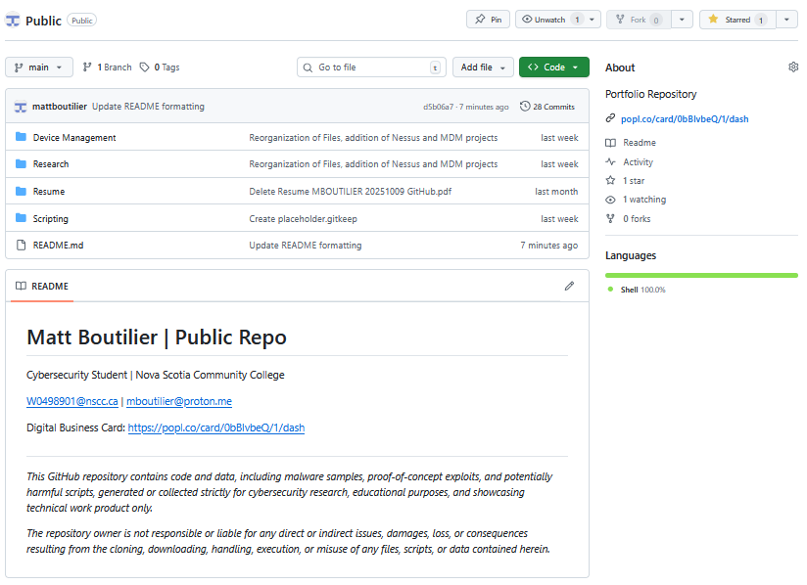
Delivery
Coursework Showcase

Slide 12
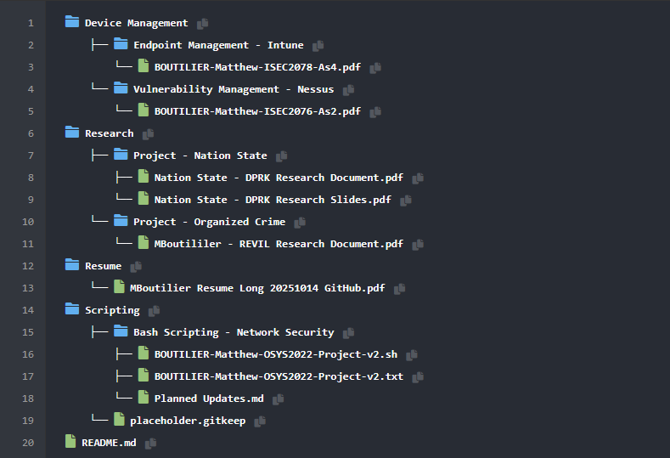

Slide 13
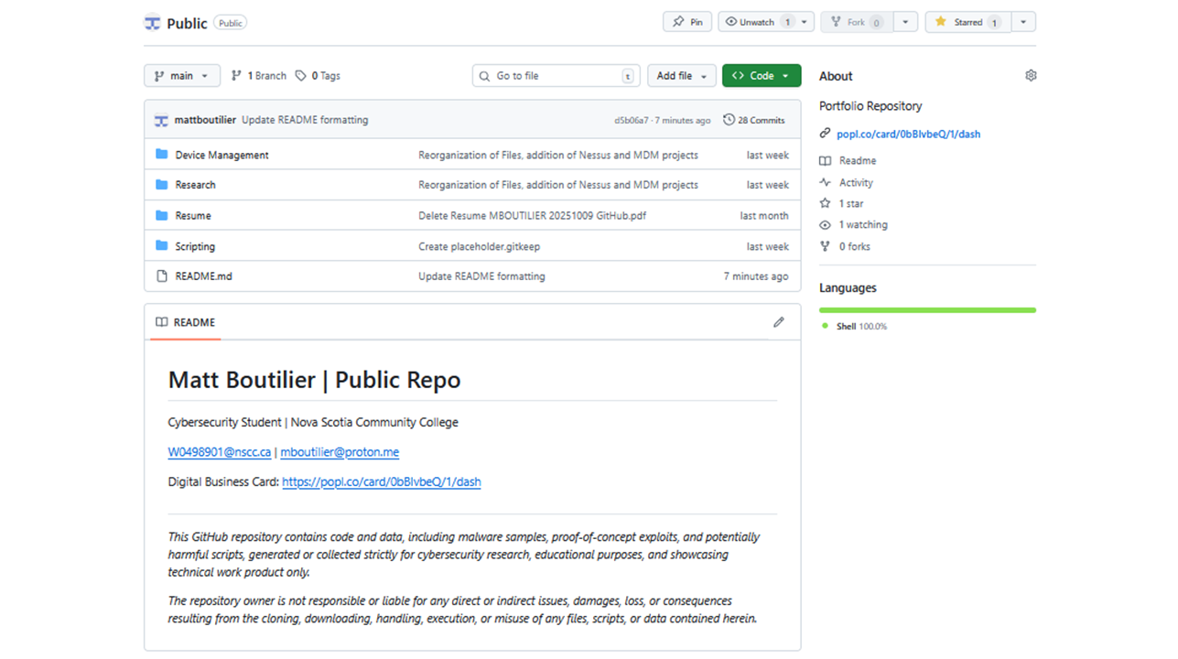
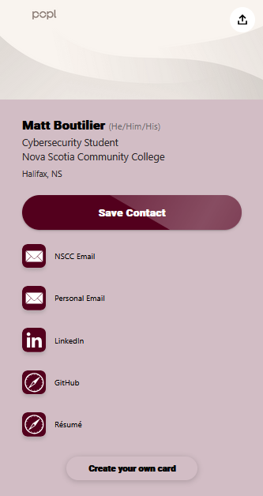

Slide 14


Professional Foundations
My experience proves a strong foundation in ethical conduct, accountability, and collaborative problem-solving, essential for any high-trust environment.
Proven Technical Knowledge
I possess hands-on, practical skills in key cybersecurity domains: device management, active threat detection, and end-to-end vulnerability management.

Slide 15
Conclusion
Professional Foundations
My experience proves a strong foundation in ethical conduct, accountability, and collaborative problem-solving, essential for any high-trust environment.
Proven Technical Knowledge
I possess hands-on, practical skills in key cybersecurity domains: device management, active threat detection, and end-to-end vulnerability management.

Slide 16


